Slide 1
Common internal difficulties
Jeff Leek
@jtleek
www.jtleek.com

Slide 2
Code of conduct
Have a policy
Open communication
Quick, impartial, enforcement

Slide 3
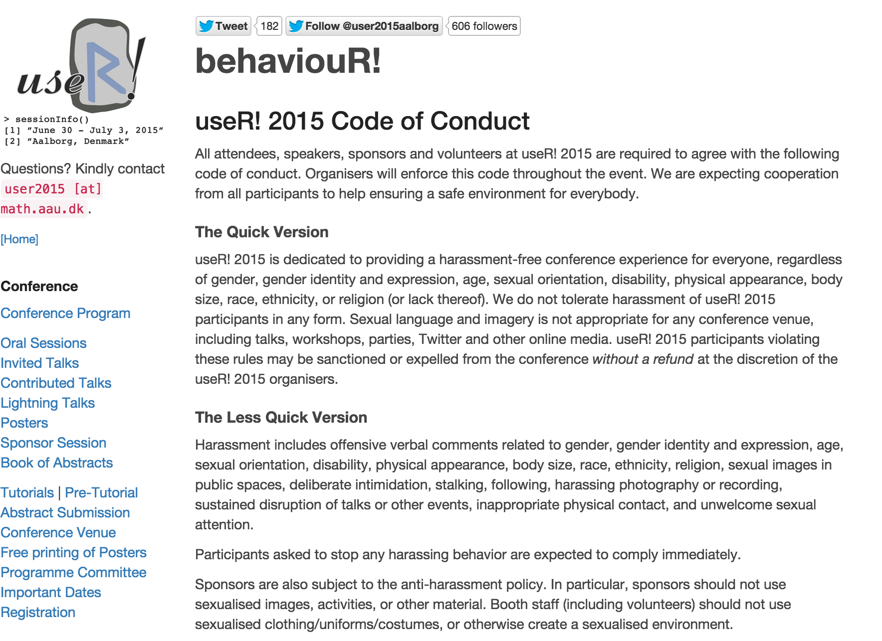
http://user2015.math.aau.dk/behaviouR

Slide 4
Inter-meeting slowdowns
Identify core issues
Increase interaction
Evaluate motivation

Slide 5
Meeting
Difficulty
Meeting
No progress
Time

Slide 6
Meeting
Meeting
Difficulty
Time

Slide 7
Frustration
Remember to motivate
Positive reinforcement
Impartial feedback

Slide 8

http://readwrite.com/2014/07/21/data-scientist-income-skills-jobs

